Slide 1


DA 204o: Data Science in Practice
Course Project
Real Time Fake News Prediction
Ritik Agrawal (ritikagarwal@iisc.ac.in)
Sanjana R (sanjana2@iisc.ac.in)
Himanshu Sharma (himanshu5@iisc.ac.in)
Mayank Teckchandani (tmayank@iisc.ac.in)
Image source: Internet

Slide 2
Journey Begins : Collecting and Understanding the Data
In today's digital age, we're drowning in information. But how much of it is true?
Social media spreads news at lightning speed.
Misinformation spreads faster than truth.
People can’t deal with 1000s of articles being generated every day.
Can machines help us detect fake news automatically?
What We Did,
Loaded a dataset of thousands of news articles (both fake and real).
Each article had a title, text content, and a label (Fake, Real).
First Impressions,
Dataset contained a mix of political, social, and general news.
Articles varied greatly in length and writing style.
We had both titles and full article text to work with.

Slide 3
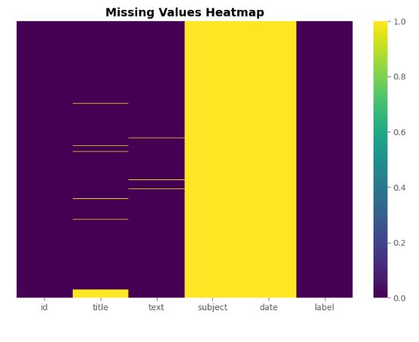
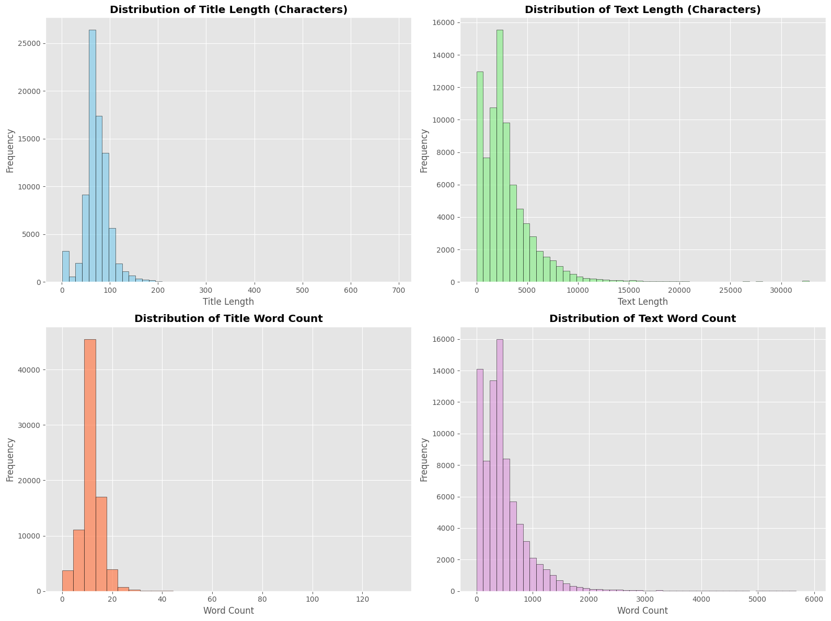
Detective Work : EDA Begins
We Started With Data Quality Check,
Missing Value Analysis,
Checked every column for missing or incomplete data.
Found some articles had missing titles or text.
Measured Everything,
Title length (characters and words).
Article length (characters and words).
Notes:
Missing Value Analysis,
Checked every column for missing or incomplete data.
Found some articles had missing titles or text.
Class Distribution,
Counted how many fake vs real articles we had.
Checked if dataset was balanced or biased.
What We Found,
Some data cleaning would be needed, and Data has enough balance to train reliable models.
Text Pattern Analysis,
Do fake news articles write differently? Are they longer or shorter?
Measured Everything,
Title length (characters and words).
Article length (characters and words).
Visualization showed,
Real news: More consistent length, professional structure.
Fake news: More variable, sometimes unusually short or long.
Titles: Fake news titles often more sensational (longer/shorter extremes).
What We Found,
Fake news doesn't follow the same writing patterns as professional journalism!

Slide 4
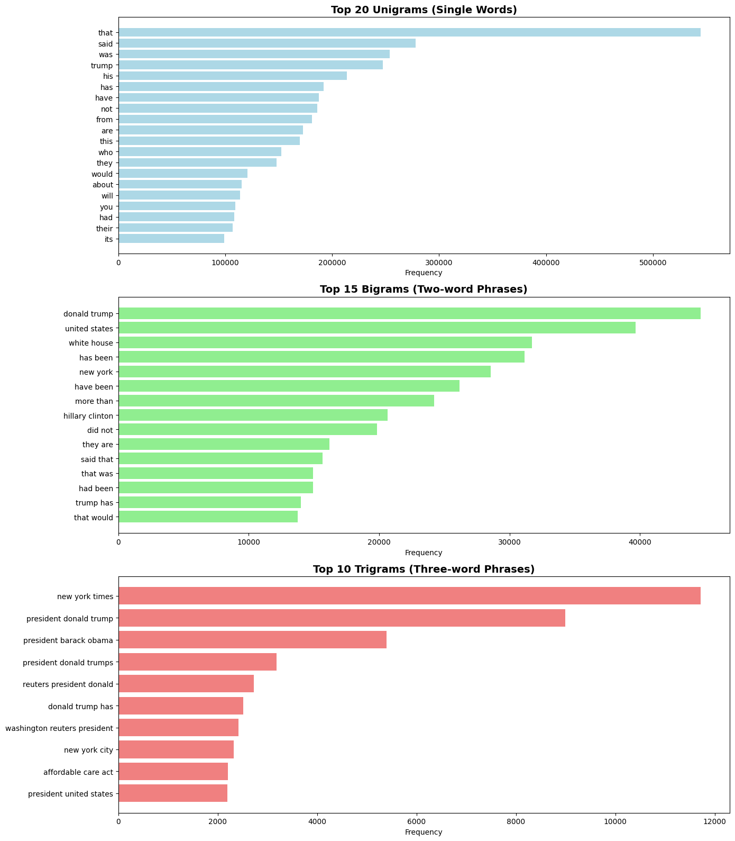
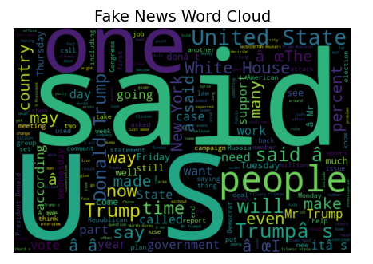

The Language Clue : Word Clouds and Frequency
What words do fake news use? Are there signature phrases?
Generated word clouds,
Separate clouds for fake vs real news.
Removed common stop words.
Highlighted most frequent terms.
Performed N gram Analysis clouds,
Unigrams ,N-grams, Bigrams
Notes:
Create word clouds,
Separate clouds for fake vs real news.
Removed common stop words.
Highlighted most frequent terms.
Visualization showed,
Real news: Professional tone, Specific names, places, dates, Balanced language.
Fake news: More capital letters, words like “Breaking”, “Shocking”, “Urgent”, Emotional and sensational language.
What We Found,
The language itself is a fingerprint!
Gram Analysis,
Single words are good, but what about phrases? Combinations might reveal more!
Unigrams (Single words),
Most common individual words overall
Bigrams (Two-word phrases),
Real :"according to", "officials said", "data shows"
Fake : "breaking news", "urgent update", "sources say"
Trigrams (Three-word phrases),
Real: "according to the", "research shows that"
Fake: "you won't believe", "this is shocking"
What We Found,
Fake news uses predictable clickbait phrases! Real news cites sources properly!

Slide 5
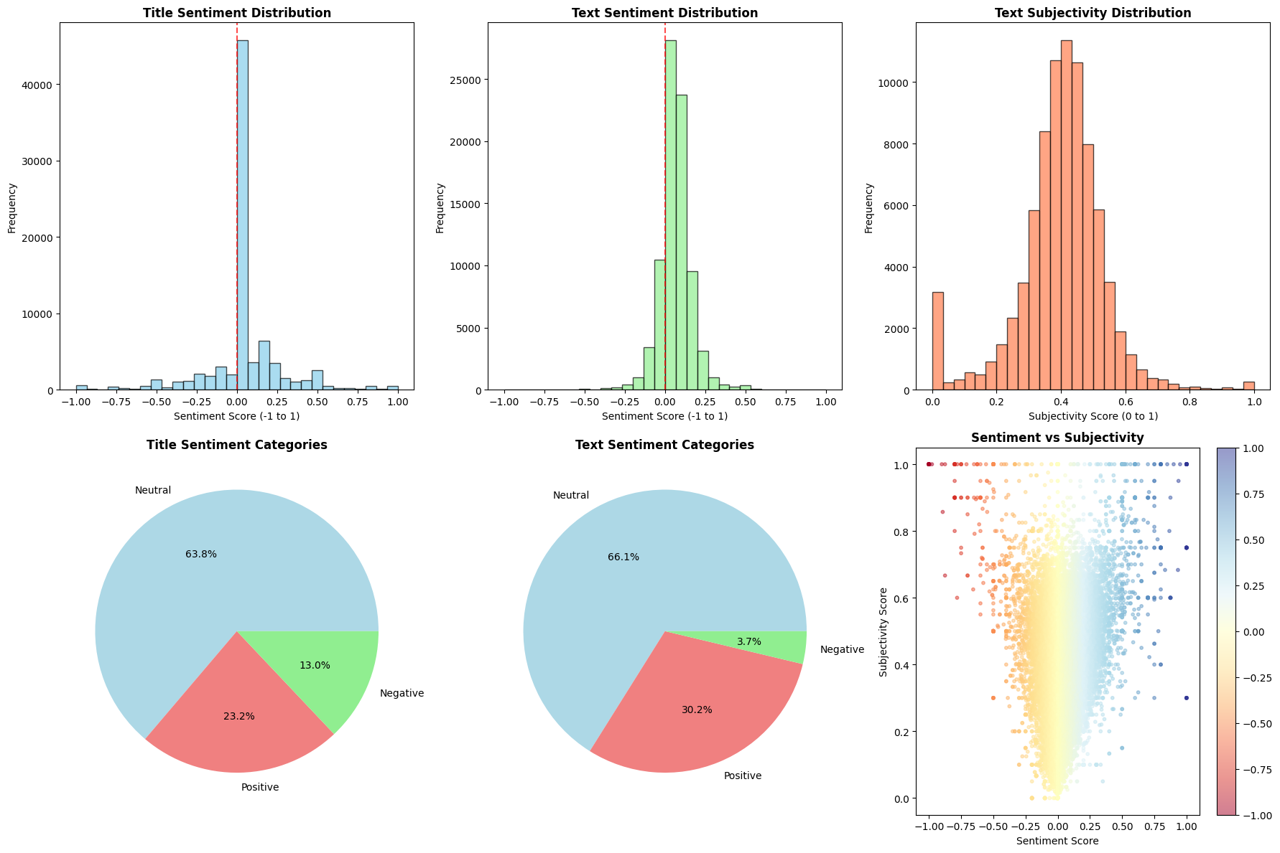
The Emotion Factor : Sentiment Analysis
Fake news probably plays with emotions. Let's measure sentiment!
Analyzed,
Sentiment Score: Positive,
Negative, or Neutral.
Subjectivity: Objective facts
vs subjective opinions.
Fake News Signature Traits,
Sensational vocabulary, Extreme sentiments and Clickbait phrases.
More punctuation (!!!, ???)
and Higher subjectivity
Notes:
Sentiment Patters,
Fake news probably plays with emotions. Let's measure sentiment!
Analyzed,
Sentiment Score: Positive, Negative, or Neutral.
Subjectivity: Objective facts vs subjective opinions.
Compared fake vs real news distributions.
Sentiment Patters,
Fake news: Extreme sentiments, Higher subjectivity scores.
Real news: More neutral, balanced sentiment.
What We Found,
Fake news triggers emotions! Real news reports facts!
EDA Completed, what we learned,
Journalism has standards. Does writing complexity differ?
Fake News Signature Traits,
Sensational vocabulary, Extreme sentiments and Clickbait phrases.
More punctuation (!!!, ???) and Higher subjectivity
Real News Characteristics,
Professional, neutral tone
Cites sources properly and Consistent structure
Balanced sentiment and Factual, objective language
We have clear patterns! Now let's build features and train models!

Slide 6
Getting Ready : Building Intelligence
Combined title + text into one field, Lowercased everything and Removed extra spaces and Fixed encoding issues.
Removed URLs (http://, www.) and special characters (@#$%^&*).
Ensured only 0 (fake) and 1 (real) labels, Removed any invalid entries and Verified data integrity.
80% for training (teaching the model), 20% for testing (evaluating performance) and Stratified split (balanced classes)
Vocabulary: Top 10,000 most common words
Sequence length: 256 tokens max
Added padding for uniform input
Title length, text length, word counts, character counts, Title-to-text ratios
Sentiment scores, Subjectivity measures
Exclamation mark count (!!!), Question mark count (???), CAPS ratio (SHOUTING?), Digit counts, Special character density.
TF-IDF vectors (word importance), N-gram feature.
Notes:
Models need numbers, not words. Let's translate our discoveries into features!
Text Statistics (15+ features),
Title length, text length, word counts, character counts, Title-to-text ratios
Emotional Indicators and Language Markers,
Sentiment scores, Subjectivity measures
Exclamation mark count (!!!), Question mark count (???), CAPS ratio (SHOUTING?), Digit counts, Special character density.
Advanced NLP,
TF-IDF vectors (word importance), N-gram features
"We've armed our models with 15+ powerful features!"

Slide 7
First Attempt : Using Logistic Regression
Base Line: Logistic Regression
Accuracy : 80.44%
ROC AUC : 0.88
 | Precision | Recall | F1-score | Support
Fake | 0.821 | 0.786 | 0.803 | 8066
Real | 0.789 | 0.823 | 0.806 | 7827
XGBoost
Accuracy : 85.14%
ROC AUC : 0.93
 | Precision | Recall | F1-score | Support
Fake | 0.908 | 0.787 | 0.843 | 8066
Real | 0.807 | 0.918 | 0.859 | 7827
Bidirectional LSTM Model
Accuracy : 86.26%
ROC AUC : 0.87
 | Precision | Recall | F1-score | Support
Fake | 0.860 | 0.871 | 0.865 | 8066
Real | 0.865 | 0.854 | 0.860 | 7827
Notes:
Logistc Regression,
Model Type: Linear Model based on the sigmoid function.
Goal: Finds the optimal weights for the 8,000 TF-IDF features to maximize the separation between the two classes (e.g., Real vs. Fake).
Hyperparameters:
max_iter=300: Ensures the solver has enough iterations to fully converge (find the optimal weights).
C=3.0: This is the inverse of the regularization strength (higher C means lower regularization). A value of 3.0 allows the model to fit the data quite closely, potentially improving accuracy, but requiring careful monitoring for overfitting.
n_jobs=-1: Utilizes all available CPU cores for fitting, ensuring fast training time.
XG boost,
Architecture/Hyperparameter,
Estimators(n_estimators):300 (total number of tree built)
Learning Rate:0.1(Step size for correction)
Tree Depth(max_depth): 6 (Control the complexity of individual trees)
Evaluation_Metric(eval_metric):logloss(monitoring training progress using logarithmic loss)
Row Sampling(subsample): 80% of data used per tree(Prevents overfitting)
Feature Sampling(colsample_bytree):80% of features used per tree(Adds further regularization)
Parallel processing:n_jobs = -1(Uses all CPU cores for fast training)
Output: Binary Prediction (Fake or Real )
What models learned from From Traditional ML Models
Fake keyword count ("breaking", "shocking", etc.)
Sentiment extremity
Exclamation marks count
Subjectivity score
Title length ratio
TF-IDF: Specific sensational words
Capitalization ratio
Question marks
Text complexity
URL presence – Moderate
LSTM,
Architecture/Hyperparameter,
Embedding Layer (10,000 vocab → 64 dimensions)
Bidirectional LSTM (64 units) ← reads forward & backward
Bidirectional LSTM (16 units)
Dense Layer (64 neurons, ReLU activation)
Dropout (50% - prevents overfitting)
Output (1 neuron, sigmoid) → Fake or Real?
Training Process,
Batch size: 30
Optimizer: Adam (lr=0.0001)
Early stopping: Patience = 2 epochs
Max epochs: 10
what model learned From Deep Learning Models
Learned to recognize clickbait patterns
Identified emotional trigger phrases
Understood context and nuance
Detected inconsistencies in narrative flow

Slide 8
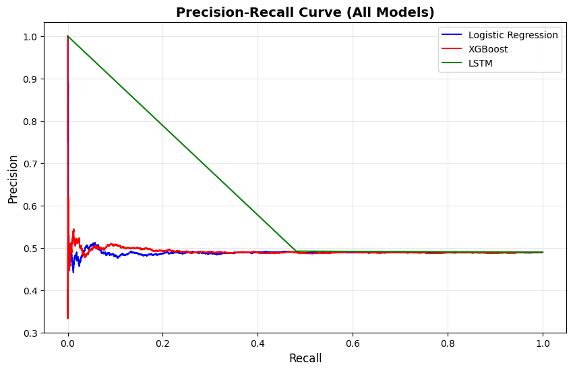
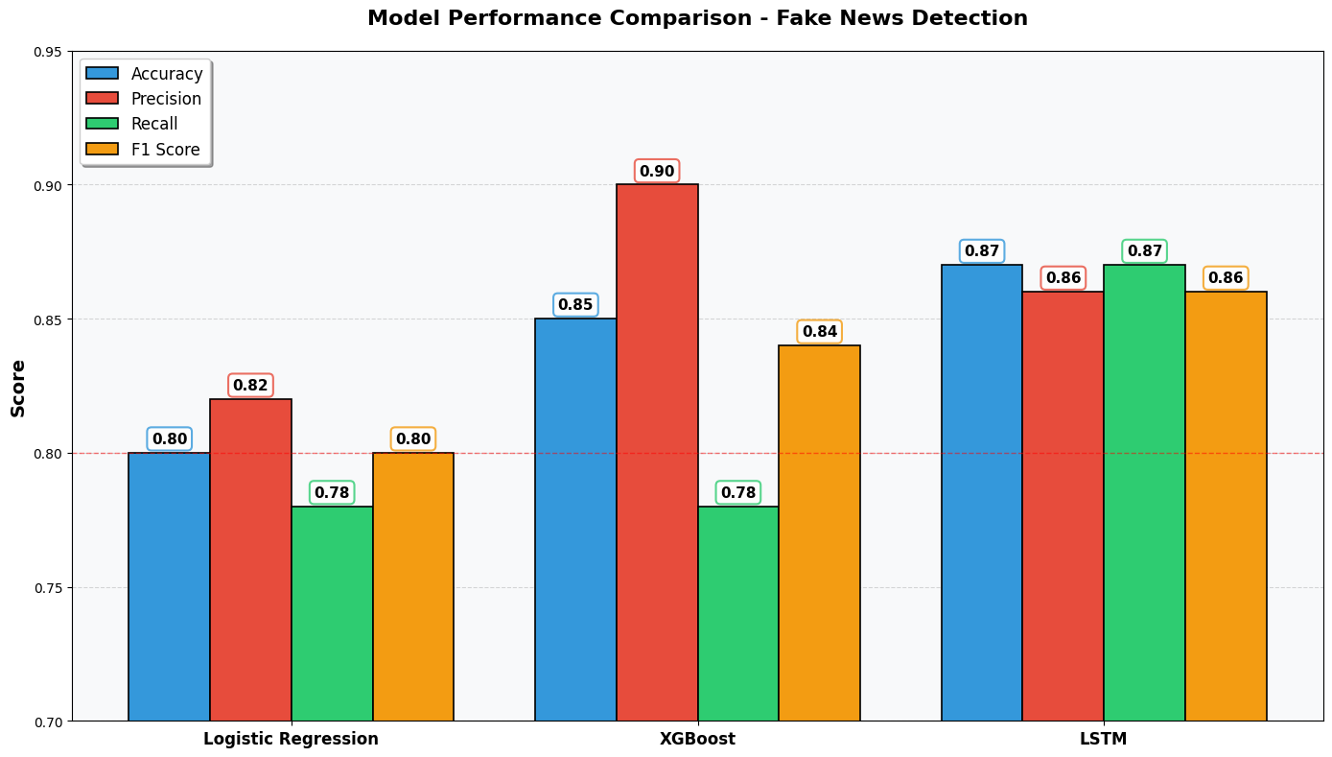
The Moment of Truth : Model Comparison
Metric | Observation (Green Line) | Strategic Implication
Initial Precision | Achieves 100% Precision at low Recall. | Model can make high-confidence "Fake" predictions with virtually no False Positives (FP).
Performance Window | Precision remains >0.50 up to Recall approx. 0.50. | Provides the best balance of catching fake news while maintaining reliability.
Conclusion | The Bidirectional LSTM model is the clear winner, demonstrating superior ability to learn the complex language patterns required for Fake News Detection.
Notes:
A Production-Ready Fake News Detector
“On the Precision–Recall curve, the LSTM model starts with 100% precision, meaning its strongest predictions are extremely reliable.
Even as we increase recall, its precision remains above 50% up to around 0.5 recall.
Logistic Regression and XGBoost fluctuate heavily, but LSTM stays smooth—showing it captures deeper contextual meaning in text."
Technical Achievements:
Analysed 80000+ news articles
Performed comprehensive EDA (15+ analyses)
Engineered 15+ meaningful features
Trained 3 different models with different variations
Achieved 87% accuracy
Created interpretable results
Saved models for production
Knowledge Gained:
Deep understanding of fake news patterns.
Hands-on of NLP and deep learning.
Experience with transformers.
Real-world ML project completion.
“On the Precision–Recall curve, the LSTM model starts with 100% precision, meaning its strongest predictions are extremely reliable.
Even as we increase recall, its precision remains above 50% up to around 0.5 recall.
Logistic Regression and XGBoost fluctuate heavily, but LSTM stays smooth—showing it captures deeper contextual meaning in text."

Slide 9
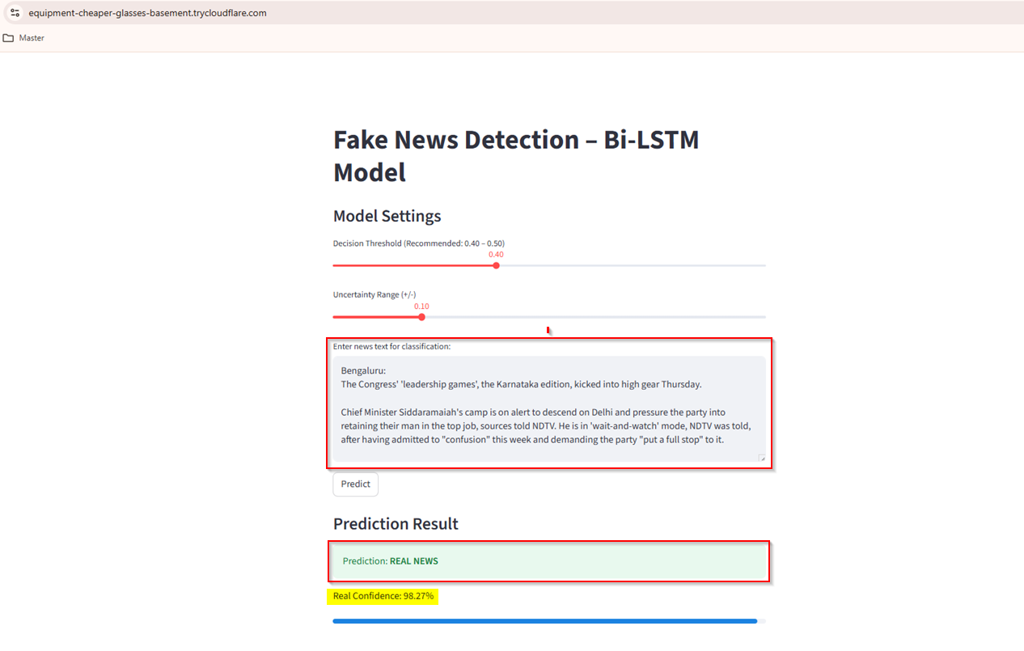
Final User Interaction : Using Streamlit
Notes:
Capabilities:
Reads any news article (title + text)
Analyzes language, sentiment, complexity
Compares against learned patterns
Returns: "Fake" or "Real" with confidence score
Reliability:
Accuracy: 87%
Catches 95% of fake news (high recall)
Only 7% false alarms (high precision)
Balanced performance across news types
Scalability:
- Determine an optimized pipeline architecture through extensive benchmarking
- Cut human involvement by 95% using a threshold confidence score for each inference.

Slide 10
Future Actions
Planned next steps include exploring transformer-based models (e.g., BERT, DistilBERT) to enhance detection accuracy and speed.
Will compare transformer models with Bi-LSTM using metrics such as accuracy, F1-score, inference time, and robustness on unseen data.
Intend to leverage transfer learning by fine-tuning pretrained transformer models on the fake news dataset for better contextual understanding.
Plan to experiment with ensemble approaches, combining predictions from LSTM, BERT, and classical models (e.g., Logistic Regression, XGBoost) using stacking or weighted averaging for improved reliability.
Aim to deploy the improved model in the existing Streamlit app, adding a BERT option and optimizing model size for real-time inference.
The project demonstrates the potential of advanced NLP and machine learning techniques in combating misinformation and sets the stage for future enhancements.

Slide 11
Lessons Learned : The Journey taught us
A Production-Ready Fake News Detector
Technical Lessons:
  Start Simple: Baseline models establish expectations
  EDA is Gold: Understanding data beats algorithms
  Features Matter: Good features > complex models
  Iterate Rapidly: Try many approaches quickly
  Validate Properly: Train/test split prevents false confidence
  Document Everything: Future you will thank present you
80% time on data, 20% on models
  No single model is always best
  Accuracy vs speed vs interpretability
  Understanding fake news helped us engineer features
  Each experiment added value

Slide 12


Thank you for Following our Journey
Notes:
The Problem is Real:
Fake news is a serious challenge affecting millions
Data Science Can Help:
With right approach, AI can detect misinformation
Our Solution Works:
87%+ accuracy proves machines can be reliable fact-checkers
We're ready to discuss:
- Technical details of any model
- Deployment strategies
- Future collaborations
- Your ideas and suggestions

